Slide 1
Independent Components Analysis with the JADE algorithm
Douglas N. Rutledge
Muséum National d'Histoire Naturelle, Paris
Laboratoire de Chimie Analytique-Faculté de Pharmacie Paris Sud, Université Paris-Saclay
douglas.neil.rutledge@gmail.com

Slide 2
Multivariate Data Analysis
Variables
Column Vectors
Samples
(objects)
(individuals)
Line Vectors

Slide 3
A matrix as points in space
X =
-1.00 0.00 0.50
1.00 -1.00 -1.00
-0.50 1.00 -1.00
1.00 1.00 -1.00
2.00 -0.50 1.00
1
0.5
0.0
-0.5
-1
1
0.5
2
0
1
-0.5
0
-1
-1

Slide 4
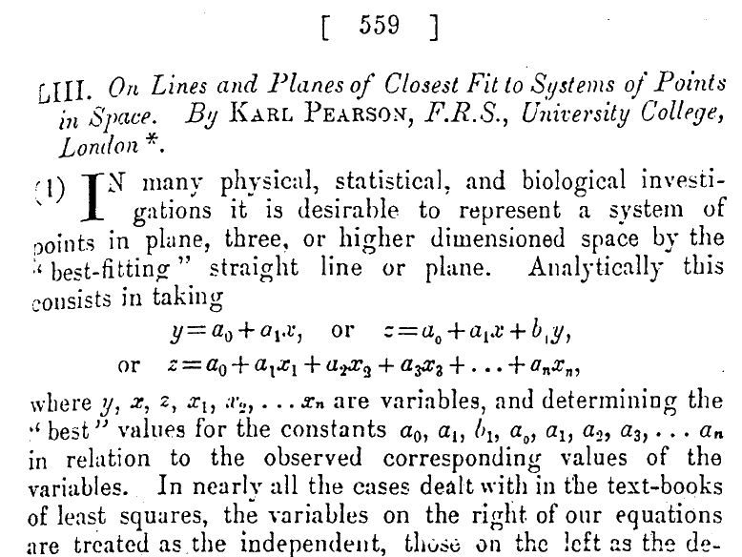
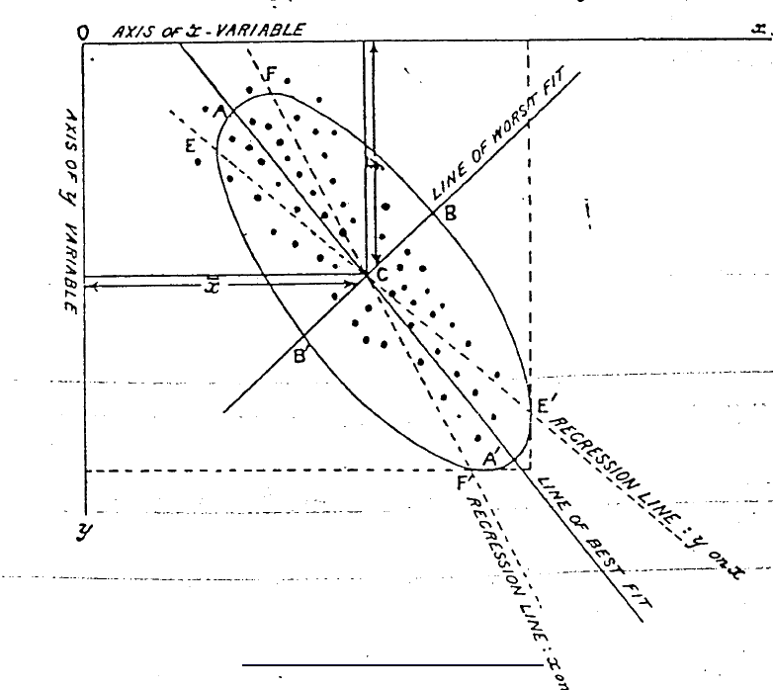
Principal Components Analysis
Pearson, 1901

Slide 5
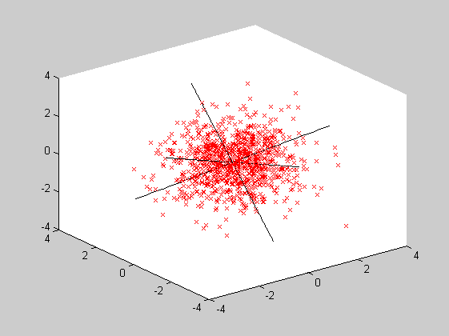
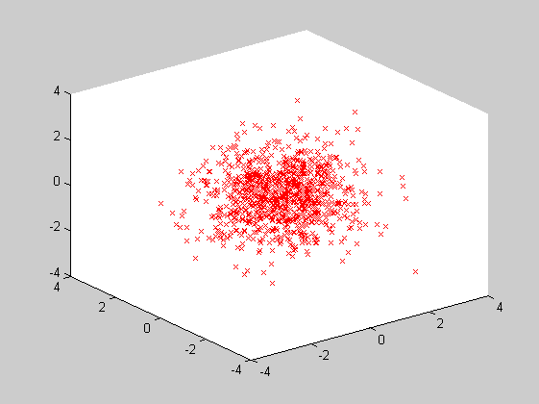
Principal Components Analysis
Samples projected onto space defined by variables
- if NO information → spherical distribution
→ NO preferred axes

Slide 6
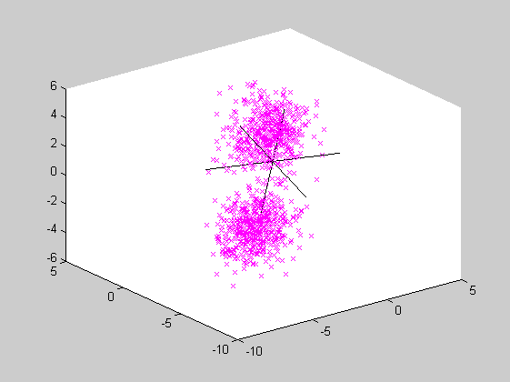
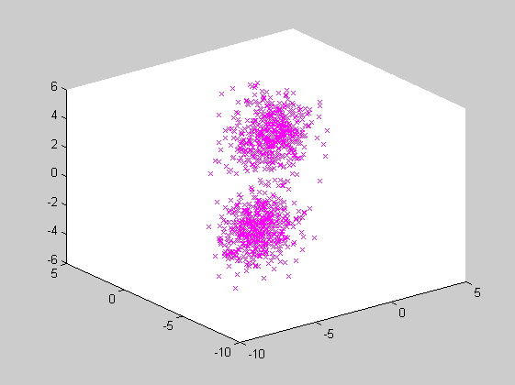
Principal Components Analysis
Samples projected onto space defined by variables
- if information → non-spherical distribution
→ preferred axes
PCA

Slide 7
“Blind Source Separation”
Variables
Row Vectors
Observed
Sensor Signals

Slide 8
Independent Components Analysis
Principal Components Analysis (PCA)
data matrix points in the multivariate space
Independent Components Analysis (ICA)
data matrix a set of observed signals, where
    each observed sensor signal is the weighted sum of pure source signals
    the weighting coefficients are proportions of the source signals
x₁ = a₁₁*s₁ + a₁₂*s₂
x₂ = a₂₁*s₁ + a₂₂*s₂
…
In matrix notation :
X = A*S

Slide 9
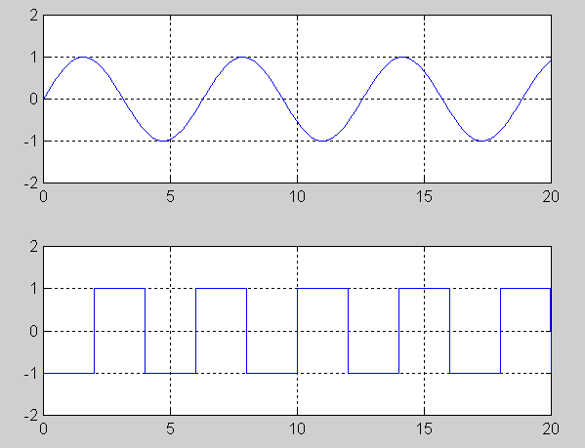
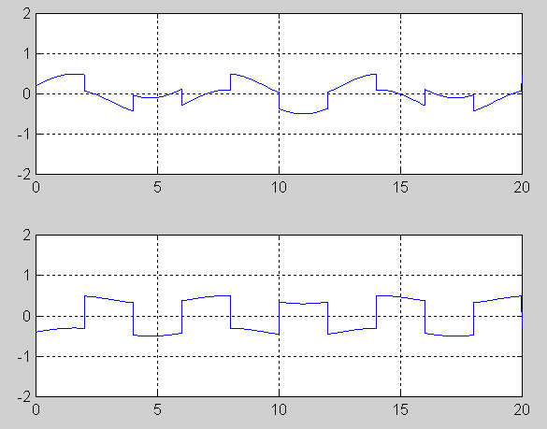
Example
Two Independent Sources
Two mixtures
a_{ij} ... Proportion of source signal s_{j} in observed signal x_{i}

Slide 10
The objective of ICA is to find "physically significant" vectors.
Hypotheses :
1) No reason for the variations in one pure signal to depend in any way on the variations in another pure signal
Pure signal sources should therefore be « independent »
2) The measured signals being combinations of several independants sources, they should be more gaussian than the sources
(Central Limit Theorem)

Slide 11
“Nongaussian is independent”: Central Limit Theorem
The measured signals being combinations of several independants sources, they should be more gaussian than the sources
Idea of ICA is to search for sources the least gaussian possible
Need to find a criterion to define the « gaussianity » of a signals :
Kurtosis
Negentropy
Mutual information
Complexity …

Slide 12
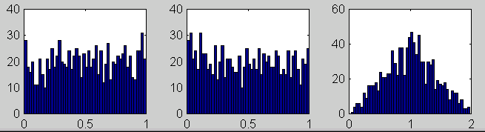
ICA Principal (Non-Gaussian is Independent)
Key to estimating A is non-gaussianity
The distribution of a sum of independent random variables tends toward a Gaussian distribution (by CLT)
f(s₁) f(s₂) f(x₁) = f(s₁ +s₂)
Where w is one of the rows of matrix W :
y is a linear combination of s_{i}, with weights given by z_{i}.
Since sum of two independent r.v. is more gaussian than individual r.v.,
so z^{T}s is more gaussian than either s_{i}
z^{T}s becomes least gaussian when equal to one of s_{i}
So we take w as a vector which maximizes the non-gaussianity of w^{T}x
.

Slide 13
Measures of Non-Gaussianity
Quantitative measure of non-gaussianity for ICA estimation
Kurtosis : gauss=0 (sensitive to outliers)
Entropy : gauss=largest
Neg-entropy : gauss = 0 (difficult to estimate)
Approximations
where v is a standard gaussian random variable and :

Slide 14
ICA :
- decomposition of a set of vectors into linear components
that are “as independent as possible”
“Independence” :
- goes beyond (second-order) decorrelation
involves the non-Gaussianity of the data

Slide 15
“Independent” versus “non-correlated”
Deux variables x et y sont indépendantes si,
quelles que soient les valeurs non nulles a et b,
r(x^a, y^b) = 0
Dans le cas présenté,
si a=2 et b=1, r=1
donc x et y ne sont pas indépendantes.

Slide 16
ICA attempts to recover the original signals by estimating a linear transformation, using a criterion that measures statistical independence among the sources
This may be achieved by the use of higher-order information that can be extracted from the densities of the data
PCA does not really look for (and usually does not find) components with physical reality
Why not ?
- PCA finds “direction of greatest dispersion of the samples”
- this is the wrong direction for “signal separation” !

Slide 17
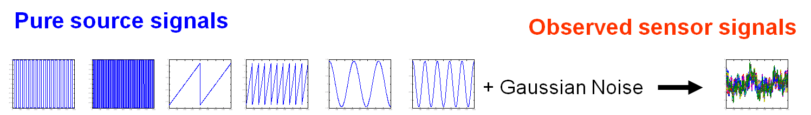
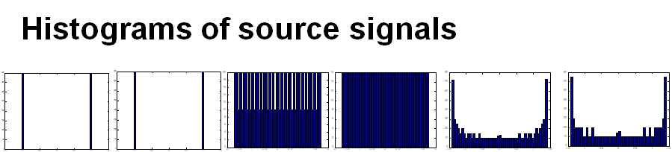
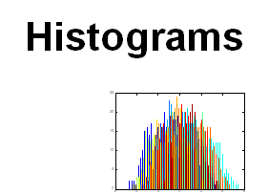
A simulated example

Slide 18
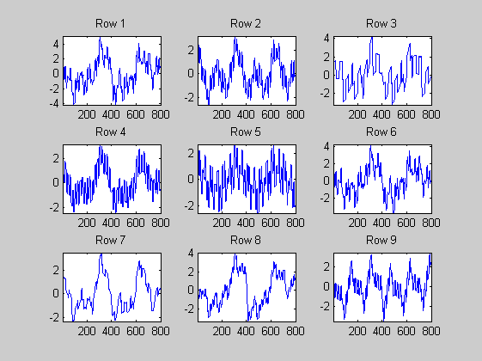
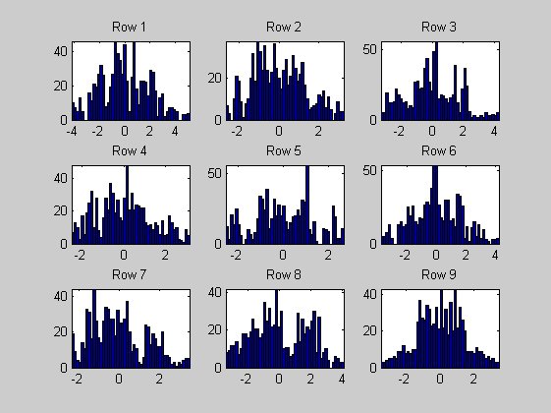
Initial data matrix
Matrix rows
Histograms

Slide 19
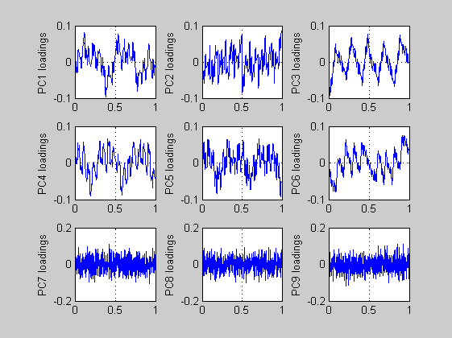
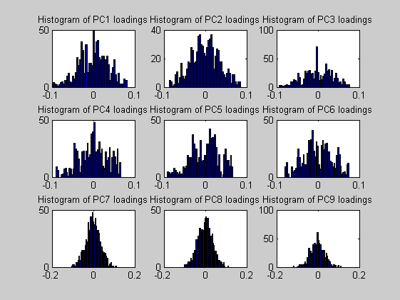
PCA applied to the example
Loadings
Histograms

Slide 20
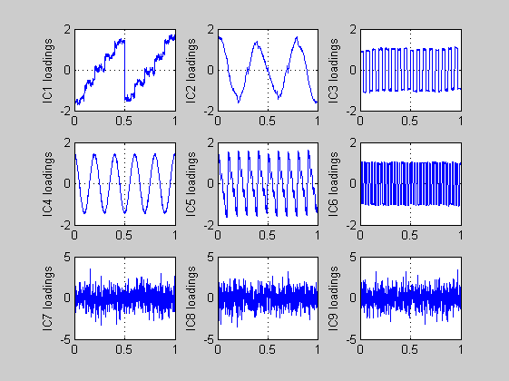
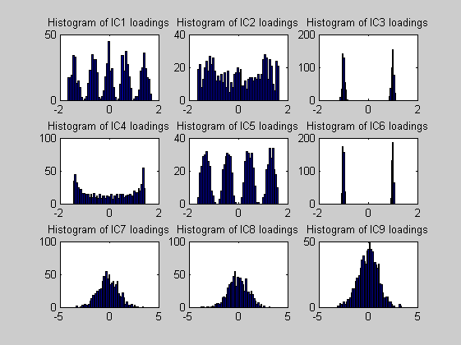
ICA applied to the example
Source Signals
Histograms

Slide 21
Procedure
ICA calculates a demixing matrix, W
W approximates A⁻¹ , the inverse mixing matrix
The pure component signals are recovered from the measured mixed signals by :
S = W*X
The trick is to calculate W when we only have X !

Slide 22
Calculating the demixing matrix
Many algorithms available :
FastICA : numerical gradient search
Projection Pursuit : interestingly structured vectors
Complexity Pursuit : minimise common information
JADE : based on “cumulants”
….

Slide 23
JADE
(Joint Approximate Diagonalization of Eigenmatrices)
JADE was developed by Cardoso et al. in 1993 [1].
A blind source separation method to extract independent non-Gaussian sources from signal mixtures with Gaussian noise
Based on the construction of a fourth-order cumulant array from the data
It is freely downloadable from
http://www2.iap.fr/users/cardoso/compsep_classic.html
[1] Cardoso and Souloumiac, IEE proceedings-F 140 (6) (1993), 362-370

Slide 24
Cumulants
For a set of values : x
2° order auto-cumulant :
σ²(x) = Cum₂{x, x} = E{x²}
4° order auto-cumulant
κ_{x}(x) = Cum₄{x, x, x, x} = E{x⁴} − 3.E²{x²}

Slide 25
Cumulants
Cumulants can be expressed in tensor form.
A tensor can be seen as a generalization of the notion of matrices.
Cumulant tensors are a generalization of covariance matrices.
The main diagonal of cumulants tensors are auto-cumulants
and non-diagonal elements are cross-cumulants.
Statistically mutually independent vectors (components) give :
- null cross-cumulants
- maximum auto-cumulants

Slide 26
Cumulants
In PCA :
The Eigenvalue decomposition of a covariance matrix results in its diagonalization, i.e. the cancellation of its non-diagonal terms.
In JADE :
A generalization of this methodology was proposed by Cardoso and Souloumiac to diagonalise fourth-order cumulants tensors.

Slide 27
Cumulants
In the simple case of 3 observed signal vectors : x₁, x₂, x₃
and 2 pure source signals : s₁, s₂
where :
x₁ = a₁₁. s₁ + a₁₂. s₂
x₂ = a₂₁. s₁ + a₂₂. s₂
x₃ = a₃₁. s₁ + a₃₂. s₂
κ(x₁) = Cum₄{x₁, x₁, x₁, x₁} = E{x₁⁴} − 3.E²{x₁²}
κ(x₁) = a₁₁⁴ . [E{s₁⁴} − 3.E²{s₁²}]
+ a₁₂⁴ . [E{s₂⁴} − 3.E²{s₂²}]
κ(x₁) = a₁₁⁴ . κ(s₁) + a₁₂⁴ . κ(s₂)

Slide 28
4th-order Cumulants
For the 3 observed signal vectors : x₁, x₂, x₃
Create a four-way array with dimensions [3, 3, 3, 3]
Each of the 81 elements is the mean of products of the vectors.
For v_{i}, v_{j}, v_{k}, v_{l} = x₁, x₂, x₃
Cum₄{v_{i}, v_{j}, v_{k}, v_{l}} = E{v_{i}v_{j}v_{k}v_{l}}
− E{v_{i}v_{j}} . E{v_{k}v_{l}}
− E{v_{i}v_{k}} . E{v_{j}v_{l}}
− E{v_{i}v_{l}} . E{v_{j}v_{k}}

Slide 29
3 Auto-Cumulants
3 different values
For v_{i}, v_{j}, v_{k}, v_{l} = x_{p} (p=1:3)
Cum₄{p, p, p, p} = E{x_{p}⁴}
− E{x_{p}²} . E{x_{p}²}
− E{x_{p}²} . E{x_{p}²}
− E{x_{p}²} . E{x_{p}²}
Cum₄{p, p, p, p} = mean (x_{p}⁴)
− mean (x_{p}²) . mean (x_{p}²)
− mean (x_{p}²) . mean (x_{p}²)
− mean (x_{p}²) . mean (x_{p}²)
Cum₄{p, p, p, p} = mean (x_{p}⁴) − 3

Slide 30
18 Even Cross-Cumulants
3 different values
For v_{i}, v_{j} = x_{p} et v_{k}, v_{l} = x_{q} (p=1:3, q=1:3, p≠q )
Cum₄{p, p, q, q} = E{x_{p}²x_{q}²}
− E{x_{p}²} . E{x_{q}²}
− E{x_{p}x_{q}} . E{x_{p}x_{q}}
− E{x_{p}x_{q}} . E{x_{p}x_{q}}
Cum₄{p, p, q, q} = mean (x_{p}²x_{q}²)
− mean (x_{p}²) . mean (x_{p}²)
− mean (x_{p}x_{q}) . mean (x_{p}x_{q})
− mean (x_{p}x_{q}) . mean (x_{p}x_{q})
Cum₄{p, p, q, q} = mean (x_{p}²x_{q}²) − 1

Slide 31
60 Odd Cross-Cumulants
9 different values
For v_{i}= x_{p} et v_{j}, v_{k}, v_{l} = x_{q} (p=1:3, q=1:3, p≠q)
Cum₄{p, q, q, q} = E{x_{p}x_{q}³}
− E{x_{p}x_{q}} . E{x_{q}²}
− E{x_{p}x_{q}} . E{x_{q}²}
− E{x_{p}x_{q}} . E{x_{q}²}
Cum₄{p, q, q, q} = mean (x_{p}x_{q}³)
− mean (x_{p}x_{q}) . mean (x_{p}²)
− mean (x_{p}x_{q}) . mean (x_{q}²)
− mean (x_{p}x_{q}) . mean (x_{q}²)
Cum₄{p, q, q, q} = mean (x_{p}x_{q}³) − 0

Slide 32
Initial X matrix
Scores of first PCs of X
Smaller, whitened X matrix
Scaled Scores of X

Slide 33
4-way tensor of cumulants

Slide 34
Initial orthogonal matrices
to project cumulants

Slide 35
Eigenmatrices of cumulants

Slide 36
JADE
Joint diagonalization using the Jacobi algorithm,
based on Givens rotation matrices :
Minimize the sum of squares of the “off-diagonal" 4th-order cumulants
(i.e. the cumulants between different signals)

Slide 37
Diagonalised matrices

Slide 38
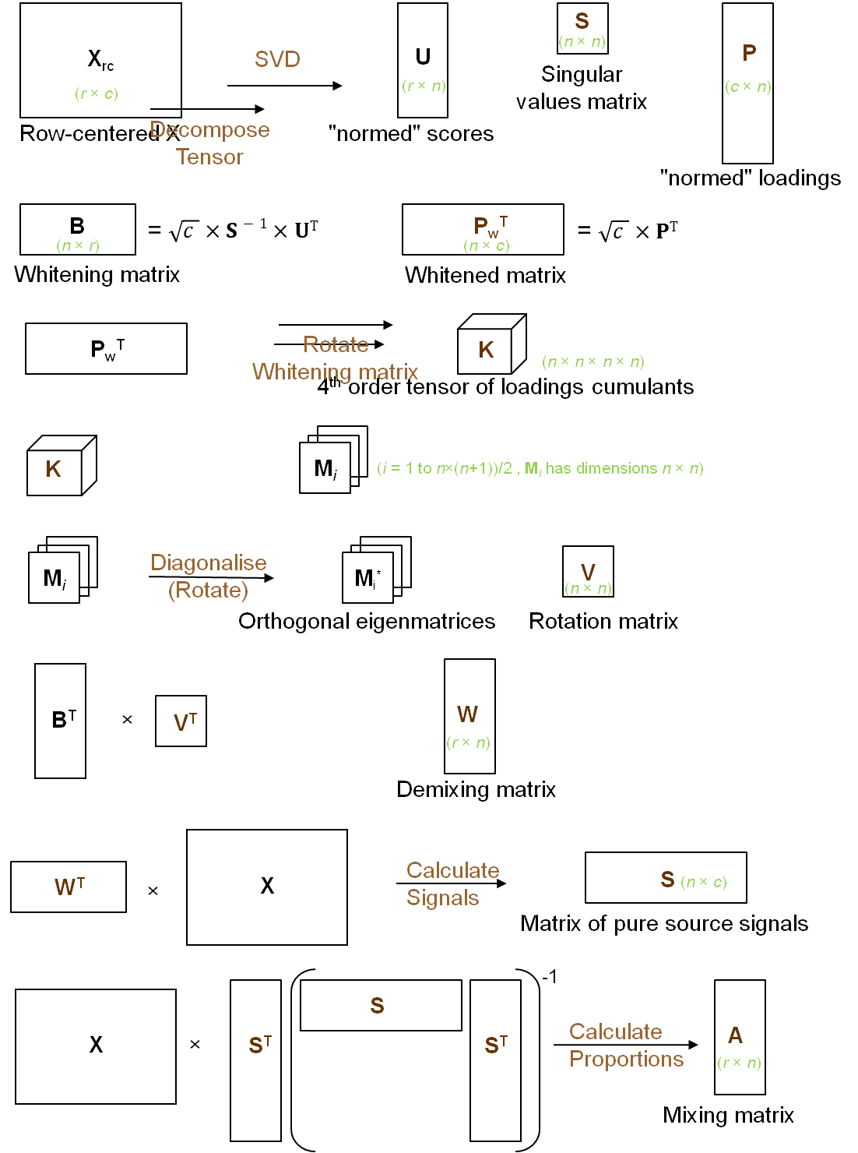
①
②
The JADE algorithm:
  a multi-step procedure
③
④
⑤

Slide 39
Summary of JADE
PCA
Scale
(x λ^{−1/2})
X
T
U
Calculate
Cumulants
Decompose
Tensor
M
U
x
X
M
Diagonalise
(Rotate)
M*
V

Slide 40
JADE
Rotate
Scores
U
x
V
W
W
Calculate
Signals
x
X
S
-1
S
S'
S'
Calculate
Prop’ns
A
X

Slide 41
Connection between PCA and ICA
Jade performs a rotation of the PCA Loadings vecctors
so as to maximze their non-gaussianity
(and therefore their independence)

Slide 42
PCA & ICA on 100 Mid-Infrared spectra
Samples : a single polystyrene film
Mid-IR spectra taken at end of production line
Acquired from 4000cm⁻¹ to 400cm⁻¹, at 1 cm⁻¹
Pre-treatment of spectra :
- normalised between 0 and 1
- neither centred nor standardised

Slide 43
Information Hidden in MIR Spectra
Source : R.Aries, D. Lidiard, R. Spragg, Spectrosc. Internat., 2(3) 41-44

Slide 44
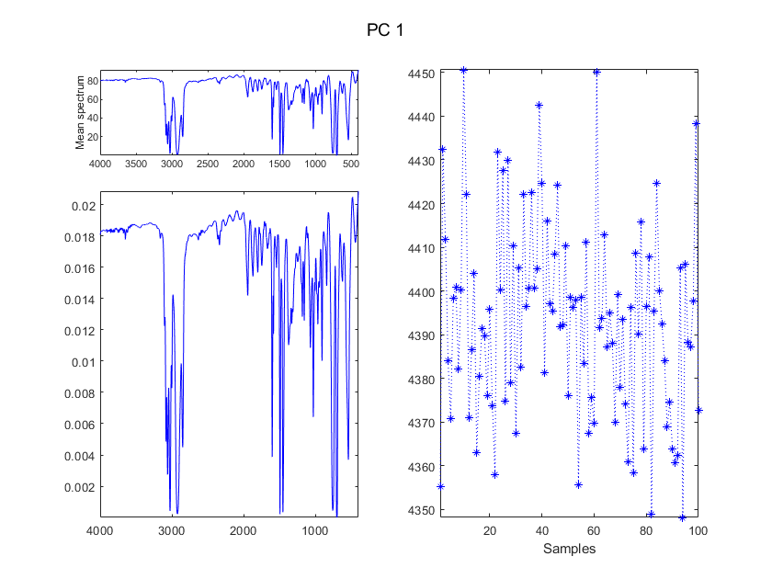
Mean spectrum

Slide 45
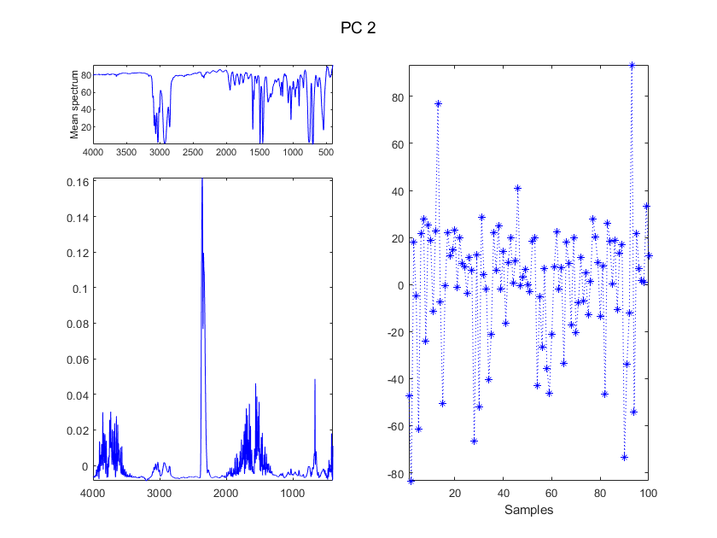
CO₂ & H₂O

Slide 46
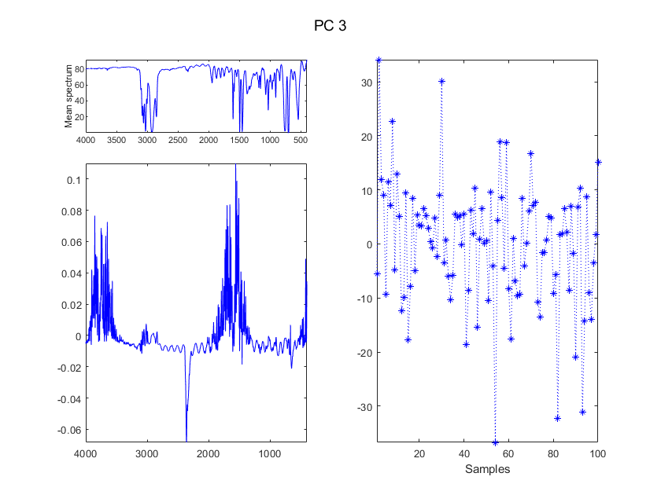
CO₂ & H₂O

Slide 47
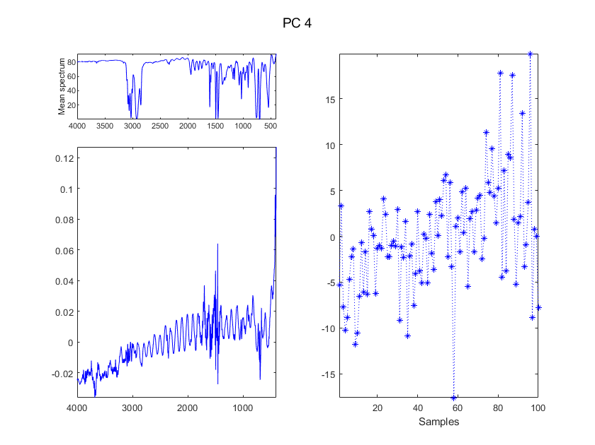

Slide 48
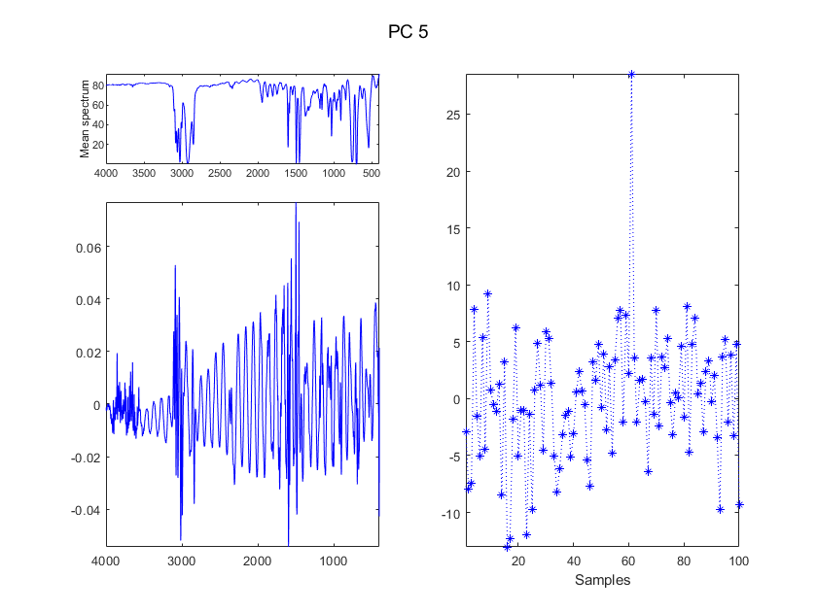
Interferogram & derivative

Slide 49
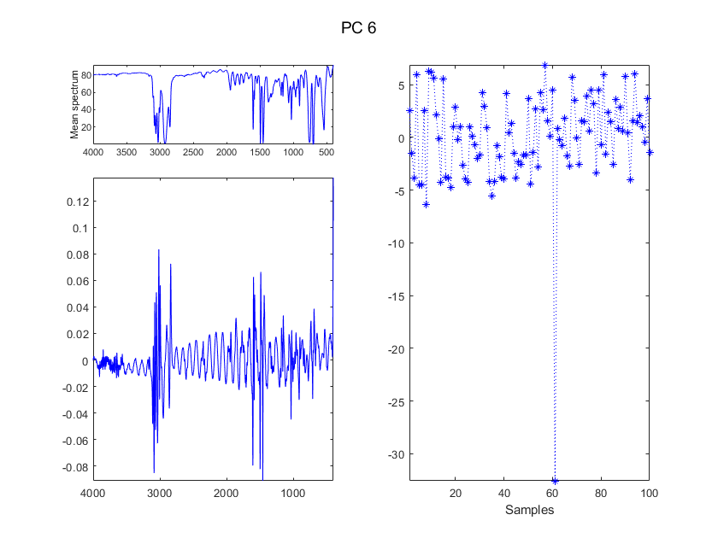
Interferogram & derivative

Slide 50
The link between PCA and ICA
ICA in JADE is a rotation of PCA Loadings to maximize their non-gaussianity
So we can do a PCA and then introduce the Loadings into JADE
Can be very useful when the X matrix is very tall !
(replace thousands of spectra by a small number of Loadings)

Slide 51
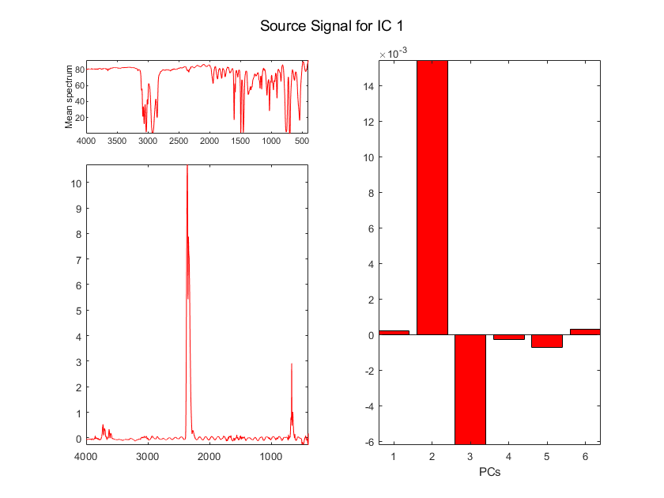

Slide 52
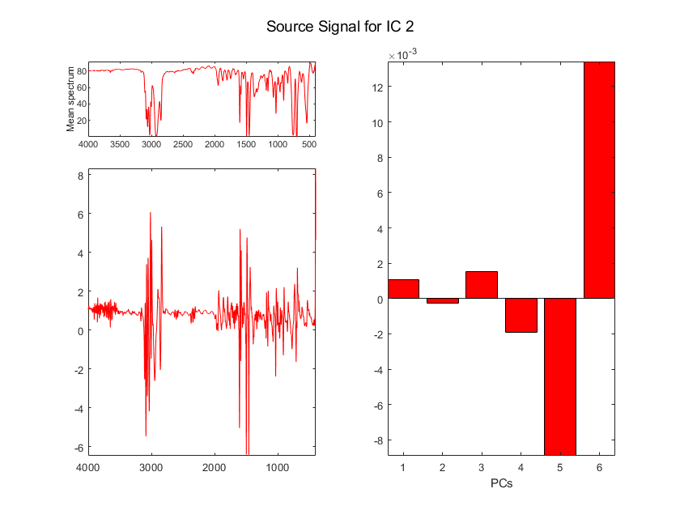

Slide 53
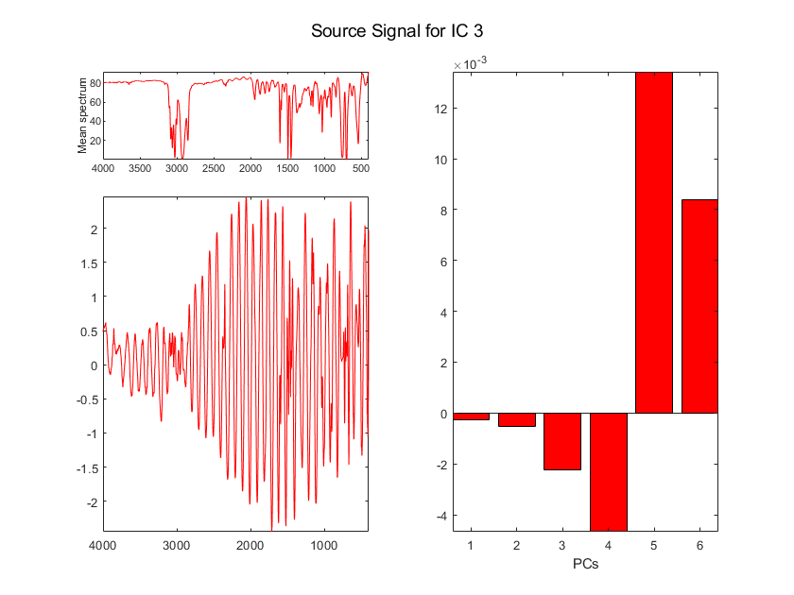

Slide 54
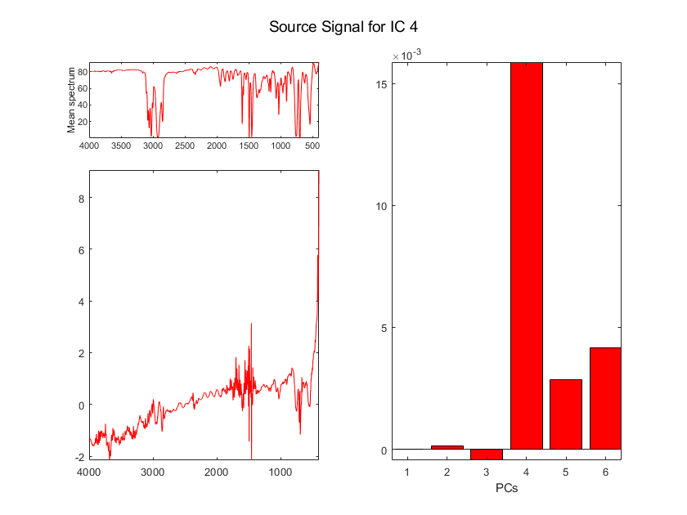

Slide 55
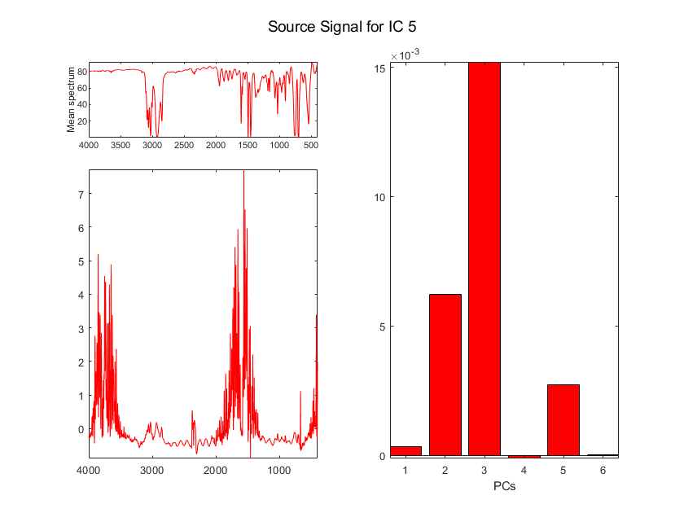

Slide 56
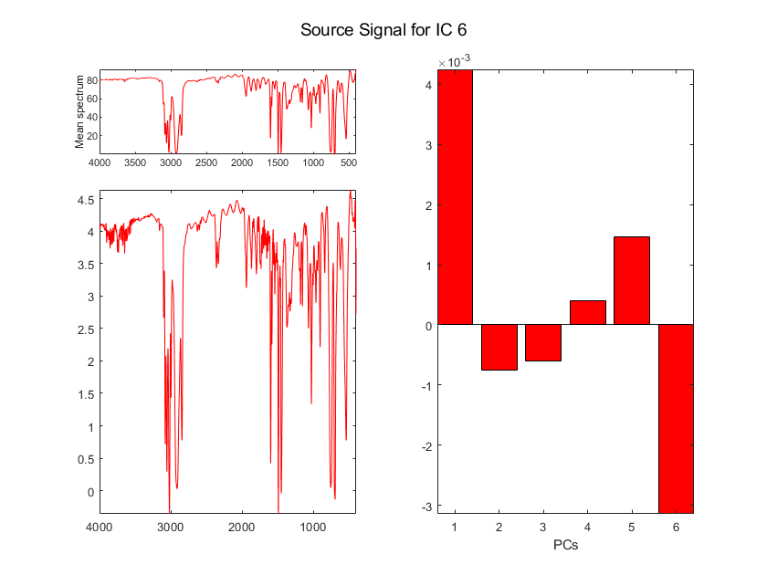

Slide 57
Calculating the ICA Proportions
The Signals extracted by JADE applied to the PCA Loadings
are exactly the same as those extracted by JADE applied to X
(because the first step in JADE is a PCA on X)
So we can recover the ICA Proportions using the same equation as in JADE
-1
S
S'
S'
Calculate
Prop’ns
A
X

Slide 58
Advantages of ICA
Extracted vectors have a physico-chemical meaning
ICA can be used to eliminate artefacts
ICA can be applied to all kinds of signals, including multi-way signals:
- Unfold the signals
- Calculate the ICA model on the matrix of one-dimensional signals
- Fold the ICs back

Slide 59
Difficulties with ICA
Different results may be obtained using different algorithms
Different results may be produced as a function of the number of Independent Components (ICs) extracted
Therefore importance of determining the number of ICs !

Slide 60
Conclusion
PCA does not look for (and usually does not find) components
with direct physical meaning
ICA tries to recover the original signals by estimating a linear transformation, using a criterion that measures statistical independence among the sources
This is done using higher-order information that can be extracted
from the densities of the data
ICA can be applied to all types of data, including multi-way data
- D.N. Rutledge, D. Jouan-Rimbaud Bouveresse,
Independent Components Analysis with the JADE algorithm
Trends in Analytical Chemistry, 50, (2013) 22–32
- D. Jouan-Rimbaud Bouveresse, D.N.Rutledge
"Independent Components Analysis: Theory And Applications“
in Resolving Spectral Mixtures, (ed. C. Ruckebusch)
Elsevier Science Publishers, Amsterdam, 2017, pp. 225-278

