Slide 1
Independent Components Analysis Determination of the number of ICs
Douglas N. Rutledge
Muséum National d'Histoire Naturelle, Paris
Laboratoire de Chimie Analytique-Faculté de Pharmacie Paris Sud, Université Paris-Saclay
douglas.neil.rutledge@gmail.com

Slide 2
Determination of the number of ICs
We have proposed several novel methods [3]:
ICA_by_Blocks correlation between signals in different blocks
with Jack-knifing
with Cross-Validation
Durbin-Watson criterion applied to residual matrices
Vector Correlation between :
- ‘Proportions’ and theoretical concentrations
- ‘Signals’ and a theoretical spectrum
Matrix correlations (RV) between blocks
with Jack-knifing
Kaiser-Meyer-Olkin measure (KMO) applied to residual matrices

Slide 3
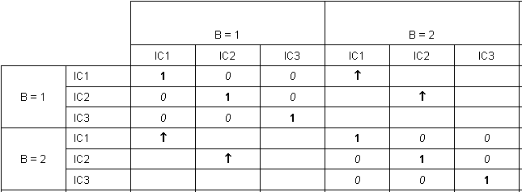
ICA_by_Blocks correlation between signals in different blocks
The data matrix is split into 2 (or more) blocks
ICA models with increasing number of ICs are calculated within each block
The ICs from each block are compared
➔ Informative ICs are correlated, while noisy ones have a low correlation.
D. Jouan-Rimbaud Bouveresse, A. Moya-González, F. Ammari, D.N. Rutledge, Chemom. Intell. Lab. Syst. 112 (2012), 24-32

Slide 4
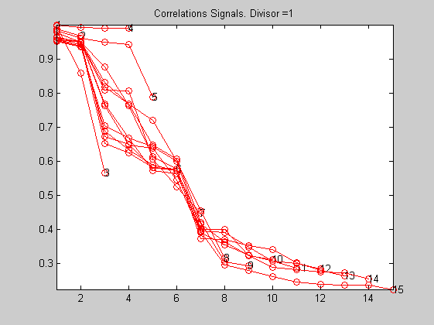
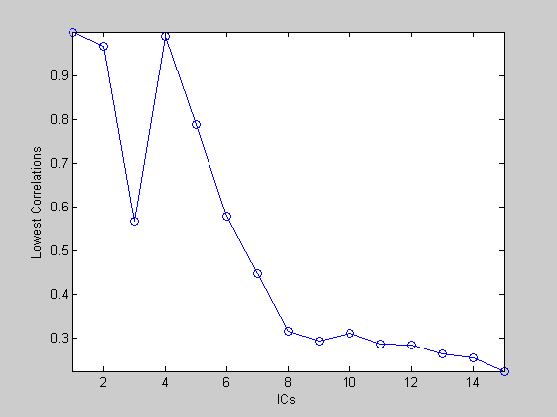
ICA_by_Blocks
The data matrix is split into 2 (or more) blocks
ICA models with increasing number of ICs are calculated within each block
The ICs from each block are compared
➔ Informative ICs are correlated, while noisy ones have a low correlations

Slide 5
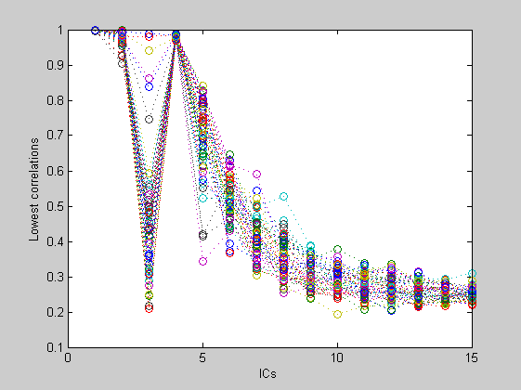
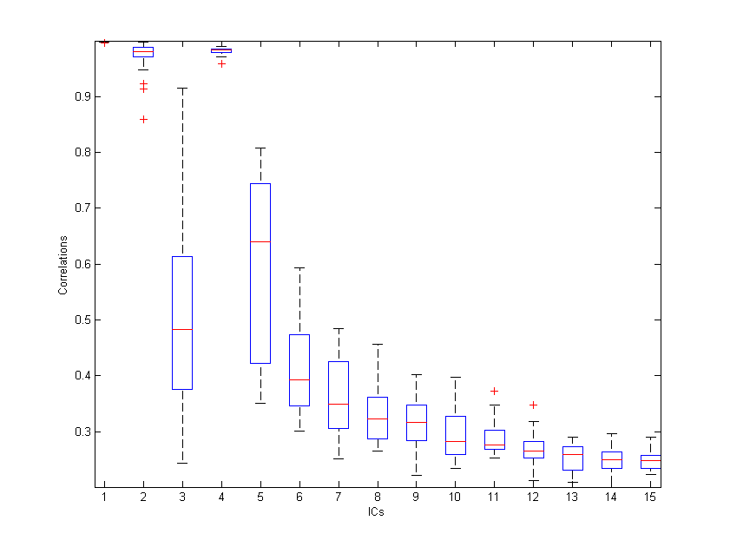
Random ICA_by_Blocks with repeated random block attributions
➔ Informative ICs are correlated, while noisy ones have a low correlations
A. Kassouf, A. Ruellan, D. Jouan-Rimbaud Bouveresse, D. N. Rutledge, S. Domenek, J. Maalouly, H. Chebib, V. Ducruet,
Talanta, (2016), 147 569–580

Slide 6
Correlation blocs

Slide 7
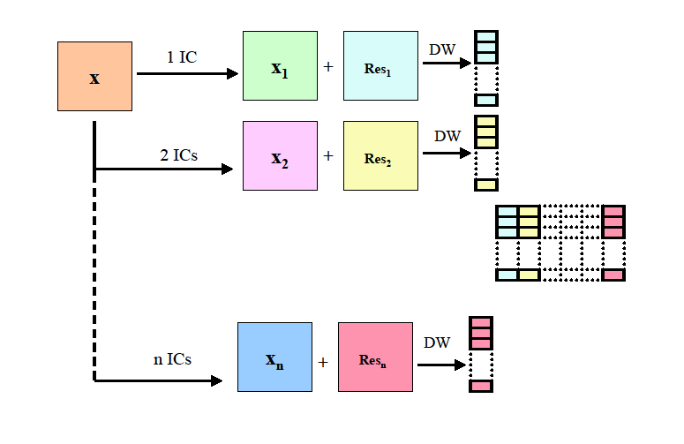
Durbin-Watson criterion applied to residual matrices
J. Durbin, G.S. Watson, Biometrika 37 (1950) 409-428
D.N. Rutledge, A.S. Barros, Anal. Chim. Acta 454 (2002) 277-295
D. Jouan-Rimbaud Bouveresse, A. Moya-González, F. Ammari, D.N. Rutledge, Chemom. Intell. Lab. Syst. 112 (2012), 24-32

Slide 8
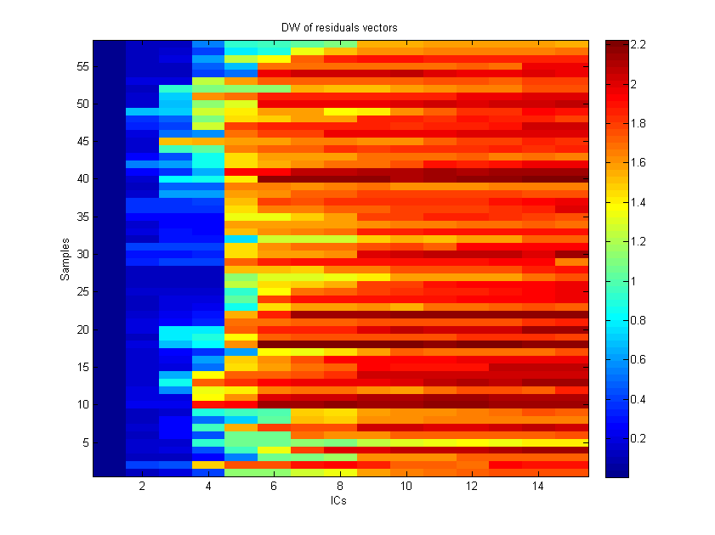
Durbin-Watson criterion

Slide 9
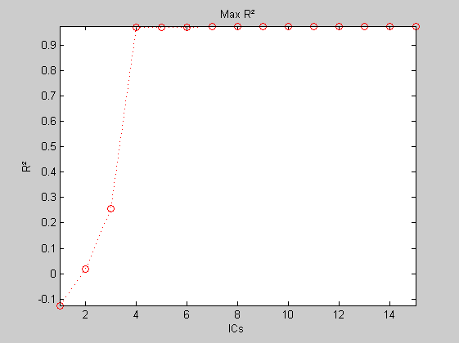
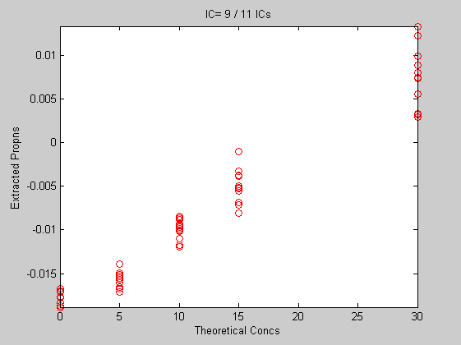
Vector Correlation between ‘Proportions’ and theoretical concentrations
A. Kassouf, A. Ruellan, D. Jouan-Rimbaud Bouveresse, D. N. Rutledge, S. Domenek, J. Maalouly, H. Chebib, V. Ducruet,
Talanta, (2016), 147 569–580

Slide 10
ICA_corr_Y (Pur 1) => IC6 / 7 ICs
Vector Correlation

Slide 11
Vector Correlation
ICA_corr_Y (Pur 1) => IC6 / 7 ICs

Slide 12
Vector Correlation between ‘Signals’ and theoretical spectrum
ICA_corr_Y (Pur 2) => IC1 / 2 ICs

Slide 13

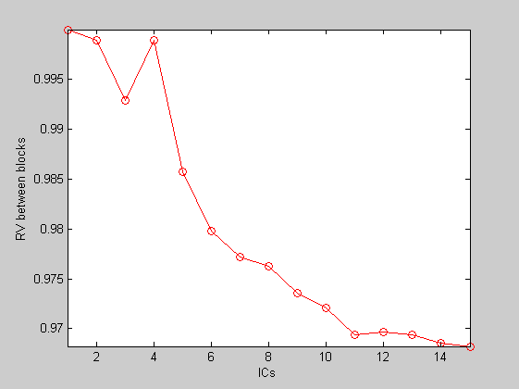
Matrix Correlation (RV) between blocks
4 ICs (Optimal number of ICs)
P. Robert, Y, Escoufier, Appl Stat , (1976);25:257–65
D. Jouan-Rimbaud Bouveresse, D.N.Rutledge, "Independent Components Analysis: Theory And Applications" in
Resolving Spectral Mixtures, (ed. C. Ruckebusch); Elsevier Science Publishers, Amsterdam, 2017, pp. 225-278

Slide 14
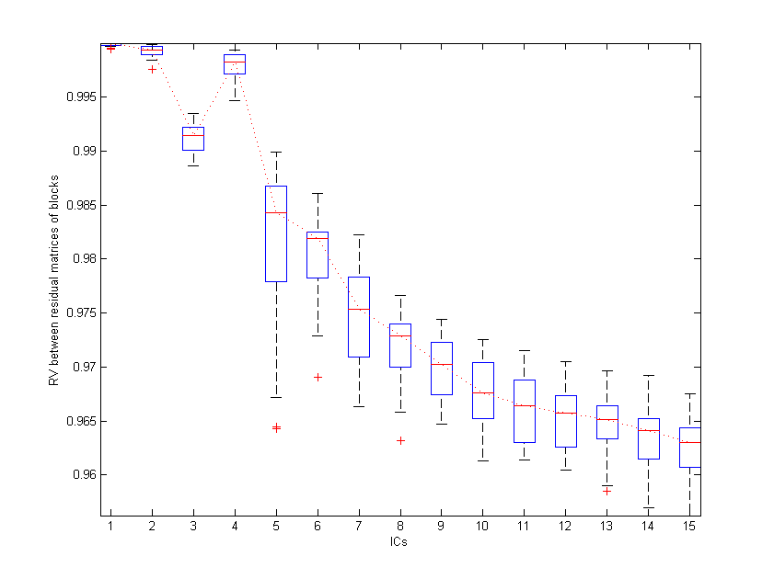
Random Matrix Correlation (RV) between blocks
with random block attributions
4 ICs (Optimal number of ICs)

Slide 15
- Kaiser-Meyer-Olkin measure (KMO)
  The Kaiser-Meyer-Olkin (KMO) index was developed to check whether the factorial analysis of a data set is pertinent
  If the original variables are orthogonal, it is useless to perform a PCA on the data
KMO =
where r_{ij} is the correlation between variables i and j,
and the partial correlation a_{ij} is defined as :
=
v_{ij} being an element of the inverse of the correlation matrix (R = [r_{ij}] = [v_{ij}]⁻¹).
H.F. Kaiser, Psychometrika. 39 (1974) 31–36.

Slide 16
- Kaiser-Meyer-Olkin measure (KMO) applied to rows of the residual matrices
  - a KMO measure near 1 indicates that there strong correlations between residual measured signals, and so all source signals have not been extracted
  - a KMO near 0.5 indicates that there are no longer any strong correlations between residual measured signals, and so all source signals have been extracted
  - an appropriate number of components can be selected by a scree plot of the KMO measures, where components before the “elbow” are retained.
A. Kassouf, D. Jouan-Rimbaud Bouveresse, D. N. Rutledge, Talanta 179 (2018) 538–545.

Slide 17
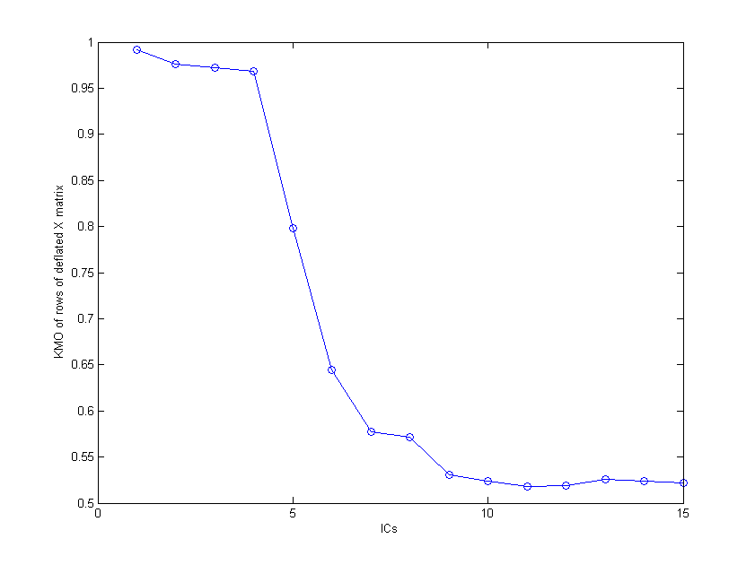
- Kaiser-Meyer-Olkin measure (KMO) applied to transposed residual matrices
4 ICs (Optimal number of ICs)

Slide 18
Conclusion
PCA does not look for (and usually does not find) components with direct physical meaning
ICA tries to recover the original signals by estimating a linear transformation, using a criterion that measures statistical independence among the sources
This is done using higher-order information that can be extracted from the densities of the data
ICA can be applied to all types of data, including multi-way data
Contributions of variables are easier to interpret

