Slide 1
PCA on a small dataset

Slide 2
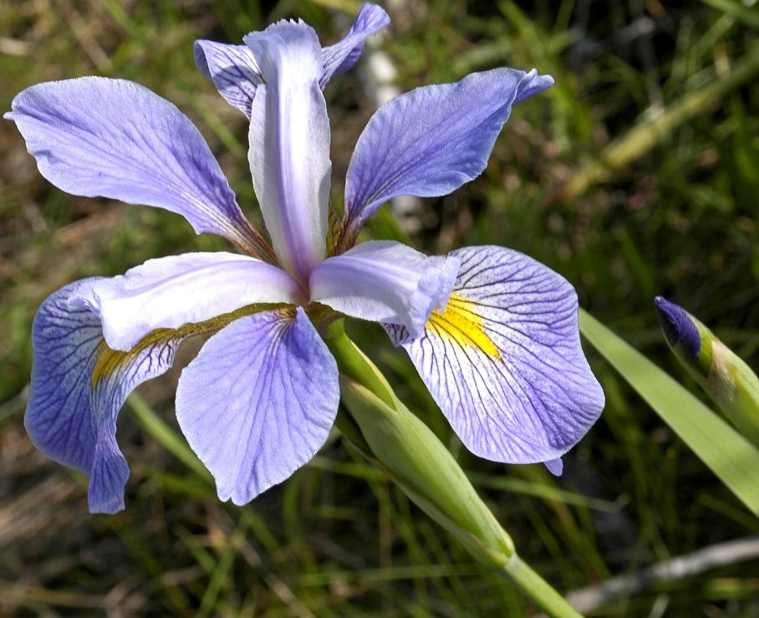
Sample | Sepal length | Sepal width | Petal length | Petal width | Species
1 | 5.1 | 3.5 | 1.4 | 0.2 | I. setosa
2 | 4.9 | 3 | 1.4 | 0.2 | I. setosa
. | . | . | . | . | .
. | . | . | . | . | .
. | . | . | . | . | .
49 | 5.3 | 3.7 | 1.5 | 0.2 | I. setosa
50 | 5 | 3.3 | 1.4 | 0.2 | I. setosa
51 | 7 | 3.2 | 4.7 | 1.4 | I. versicolor
52 | 6.4 | 3.2 | 4.5 | 1.5 | I. versicolor
. | . | . | . | . | .
. | . | . | . | . | .
. | . | . | . | . | .
99 | 5.1 | 2.5 | 3 | 1.1 | I. versicolor
100 | 5.7 | 2.8 | 4.1 | 1.3 | I. versicolor
101 | 6.3 | 3.3 | 6 | 2.5 | I. virginica
102 | 5.8 | 2.7 | 5.1 | 1.9 | I. virginica
. | . | . | . | . | .
. | . | . | . | . | .
. | . | . | . | . | .
149 | 6.2 | 3.4 | 5.4 | 2.3 | I. virginica
150 | 5.9 | 3 | 5.1 | 1.8 | I. virginica
Fisher’s Iris data
Measurements (in cm) of the length and width of sepals and petals of 50 samples of each of 3 species of Iris
By Frank Mayfield - Iris virginica

Slide 3
Species
Cyan = setosa
Red = versicolour
Blue = virginica
Note that each pair of variables appears twice in this matrix

Slide 4
Species
+ Cyan = setosa
^ Red = versicolour
o Blue = virginica

Slide 8
Two ways of showing how much variance the PCs explain
This one is sometimes called a scree plot
This one is probably more useful

Slide 9
It is usual to centre each variable by subtracting its mean before carrying out the PCA. Most software will do this by default. This is a PCA on the uncentred Iris data
The bottom left corner of each plot is the point (0,0)

Slide 10
(Centering and) Scaling the variables – for each variable subtract the mean and divide by the standard deviation before doing the PCA. The standard deviations here are 0.83, 0.44, 1.77, 0.77 and the effect isn’t very great. Sometimes, e.g. variables with different units, it is important to scale. Sometimes it is better not to. Some software calls these options “Covariance” (unscaled) and “Correlation” (scaled).
This one used centred but unscaled data
This one used centred and scaled data

Slide 11
A bit of maths and computing to finish with
function [S,L,v] = pcatf(X,k)
% PCA
% usage [S,L,v] = pcatf(X,k)
% input X - n x p matrix of spectra (in rows)
% k - number of components to return
% output S - n x k matrix of scores
% L - p x k matrix of loadings
% v - eigenvalues
X = X - ones(size(X,1),1)*mean(X);
[U,E,V] = svd(X,0);
S = U(:,1:k); % scores
e = diag(E);
e = e(1:k);
v = e.^2; % variance explained
L = V(:,1:k)*diag(1./e); % loadings
This is the important line. When n>p the singular value decomposition (SVD) decomposes X as
X=UEV^{T} where U is an n×p matrix of scores, E is a diagonal p×p matrix of singular values, and V is a p×p matrix of loadings (in columns). U and V are such that U^{T}U = I and V^{T}V = I.
There is a choice to be made here about scaling. You want XL=S, but XV=UEV^{T}V=UE, so either S=UE or L=VE⁻¹ . I have gone with the second option. Other scalings are possible.

